Slide 1

EDA Project – AMCAT Data Analysis
Submitted by : Sravani Duggu

Slide 2
About Me
Greetings to all !
My Name is Sravani Duggu. I have done BSC in Computer Science from Krishna Chaitanya Degree College where I laid the groundwork for my passion for technology and problem-solving.
Why Data Science?
My curiosity about the untapped potential of data drives my ambition to learn Data Science. I see it as the key to unlocking insights that can shape decisions and strategies across industries. With my programming and analytical background, I’m excited to delve into this field, harnessing data to create innovative solutions that can make a meaningful impact
Work Experience:
While I may not have extensive professional experience yet, I’ve honed my skills through an internship focused on front-end development. This opportunity allowed me to immerse myself in web technologies and cultivate a solid foundation in programming. Additionally, I’ve worked on various projects where I utilized my skills in data manipulation and analysis, bringing concepts to life.
LinkedIn: https://www.linkedin.com/in/sravani-duggu/
GitHub: https://github.com/Sravani-Duggu

Slide 3
Problem Statement & Use Case Domain Understanding
Problem Statement:
To perform Exploratory Data Analysis (EDA) on the AMCAT Dataset to understand salary trends. The objective is to consider salary as the target variable and analyze its relationship with other factors influencing salaries for graduates, such as specialization, job designation, and geographical location.
Use Case Domain:
Educational and Employment Market
Targeting salary predictions, specialization trends, and job designations for fresh graduates to provide actionable insights for job seeker, educational institutions, and employers.

Slide 4
Objective of the Project
Objective:
Analyze the Graduate Dataset: Examine the dataset to uncover pattern in salary distribution, job roles, gender differences, and educational backgrounds of graduates.
Identifying influential Factors: Determine how education level, specialization, geographic location, and job designation affect salary.
Provide Actionable Insights: Equip stakeholders (graduates, institutions, employers) with data-driven information better decision-making in career planning and recruitment.

Slide 5
Summary of the Dataset
The dataset used for this exploratory data analysis (EDA) is the Aspiring Mind Employment Outcome 2015 (AMEO) Dataset. This study focuses exclusively on student from engineering disciplines, containing essential employment outcomes for engineering graduates, such as salary, job title, and job locations.
Data-Size: The dataset contains a total of 3,998 records, providing a robust sample for analysis.
Target Variable: The primary focus of this analysis is the Salary of graduates, serving as the target variable.
Numerical Columns: 10th percentage, 12th percentage, College GPA, English, Logical, Quant.
Categorical Columns: Designation, Job City, Gender, Degree, Specialization, College State.

Slide 6
Data Cleaning Steps
Initial Data Inspection: Loaded the dataset and examined its structure using functions like head(), info( ), and describe( ) to understand the data types and identify any immediate issues.
Removing Unnecessary Columns: Removed any unnecessary and unnamed columns that did not contribute to the analysis, streamlining the dataset for better focus.
Handling Missing Values: Checked for missing/null values in the dataset using functions like isnull( ) or isna( ).
Removing Duplicates: Checked for and removes duplicate records using drop_duplicates( ) to ensure each entry was unique.
Outlier Detection: Identified outliers using visualization techniques or statistical methods and decided on an appropriate course of action.
Final Data Inspection: Conducted a final inspection of the cleaned dataset using info( ) and describe( ) to ensure all cleaning steps were successful and the data was ready for analysis.

Slide 7
Data Manipulation Steps
Date Format Standardization:
Converted the DOJ and DOB columns to consistent datetime format.
Handling Dynamic Entries in DOL:
Converted DOL column to datetime where applicable, and left as ‘present’ for ongoing employment.
Capping Outliers in Salary:
Calculated the 99th percentile for the salary column to identify extreme outliers.
Capped salaries above 99th percentile at the calculated value to reduce the impact of outliers without removing data.

Slide 8
Non-Visual Analysis of Target Variable, Salary
Minimum Salary: 35000.0
Maximum Salary: 4000000.0
Mean: 307699.8499249625
Median: 300000.0
Range: 3965000.0
IQR: 190000.0
Standard Deviation: 212737.49995685622
Skewness: 6.451081166224832
Kurtosis: 80.92999627162538

Slide 9
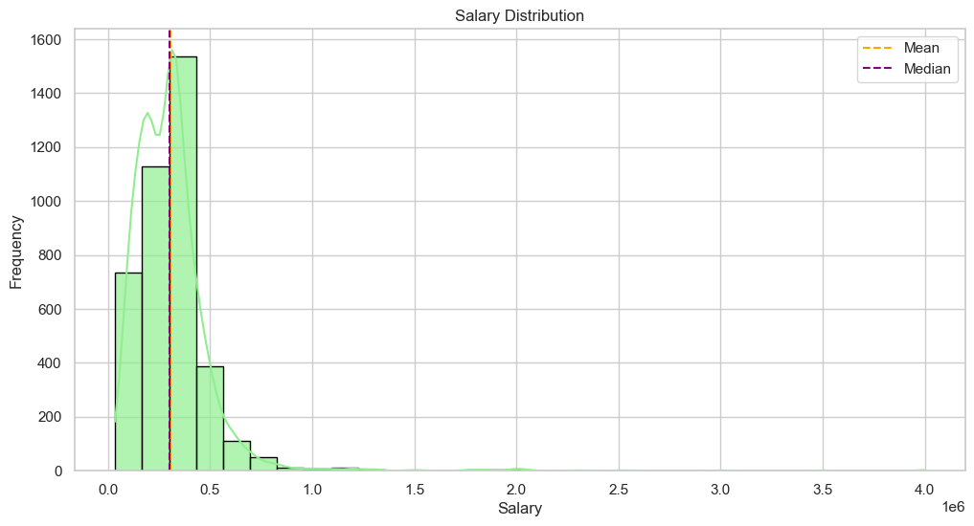
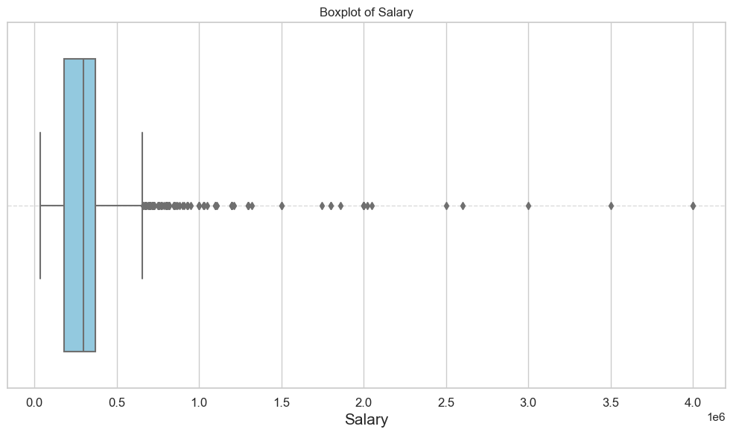
Visual Analysis of Target Variable, Salary
The histogram shows a right-skewed distribution, indicating that most of the salary data points are concentrated in lower range, with a long tail on the right.
Majority of the graduates and post graduates earn below-average salaries, while a few individuals with very high salaries pull the mean higher.
The boxplot shows the salary data distribution, with a clear concentration of data within the lower quartiles. A large number of outliers are present, confirming that many data points are much higher than the majority.
Outliers are visible far beyond the whiskers, representing individuals earning significantly higher salaries.

Slide 10
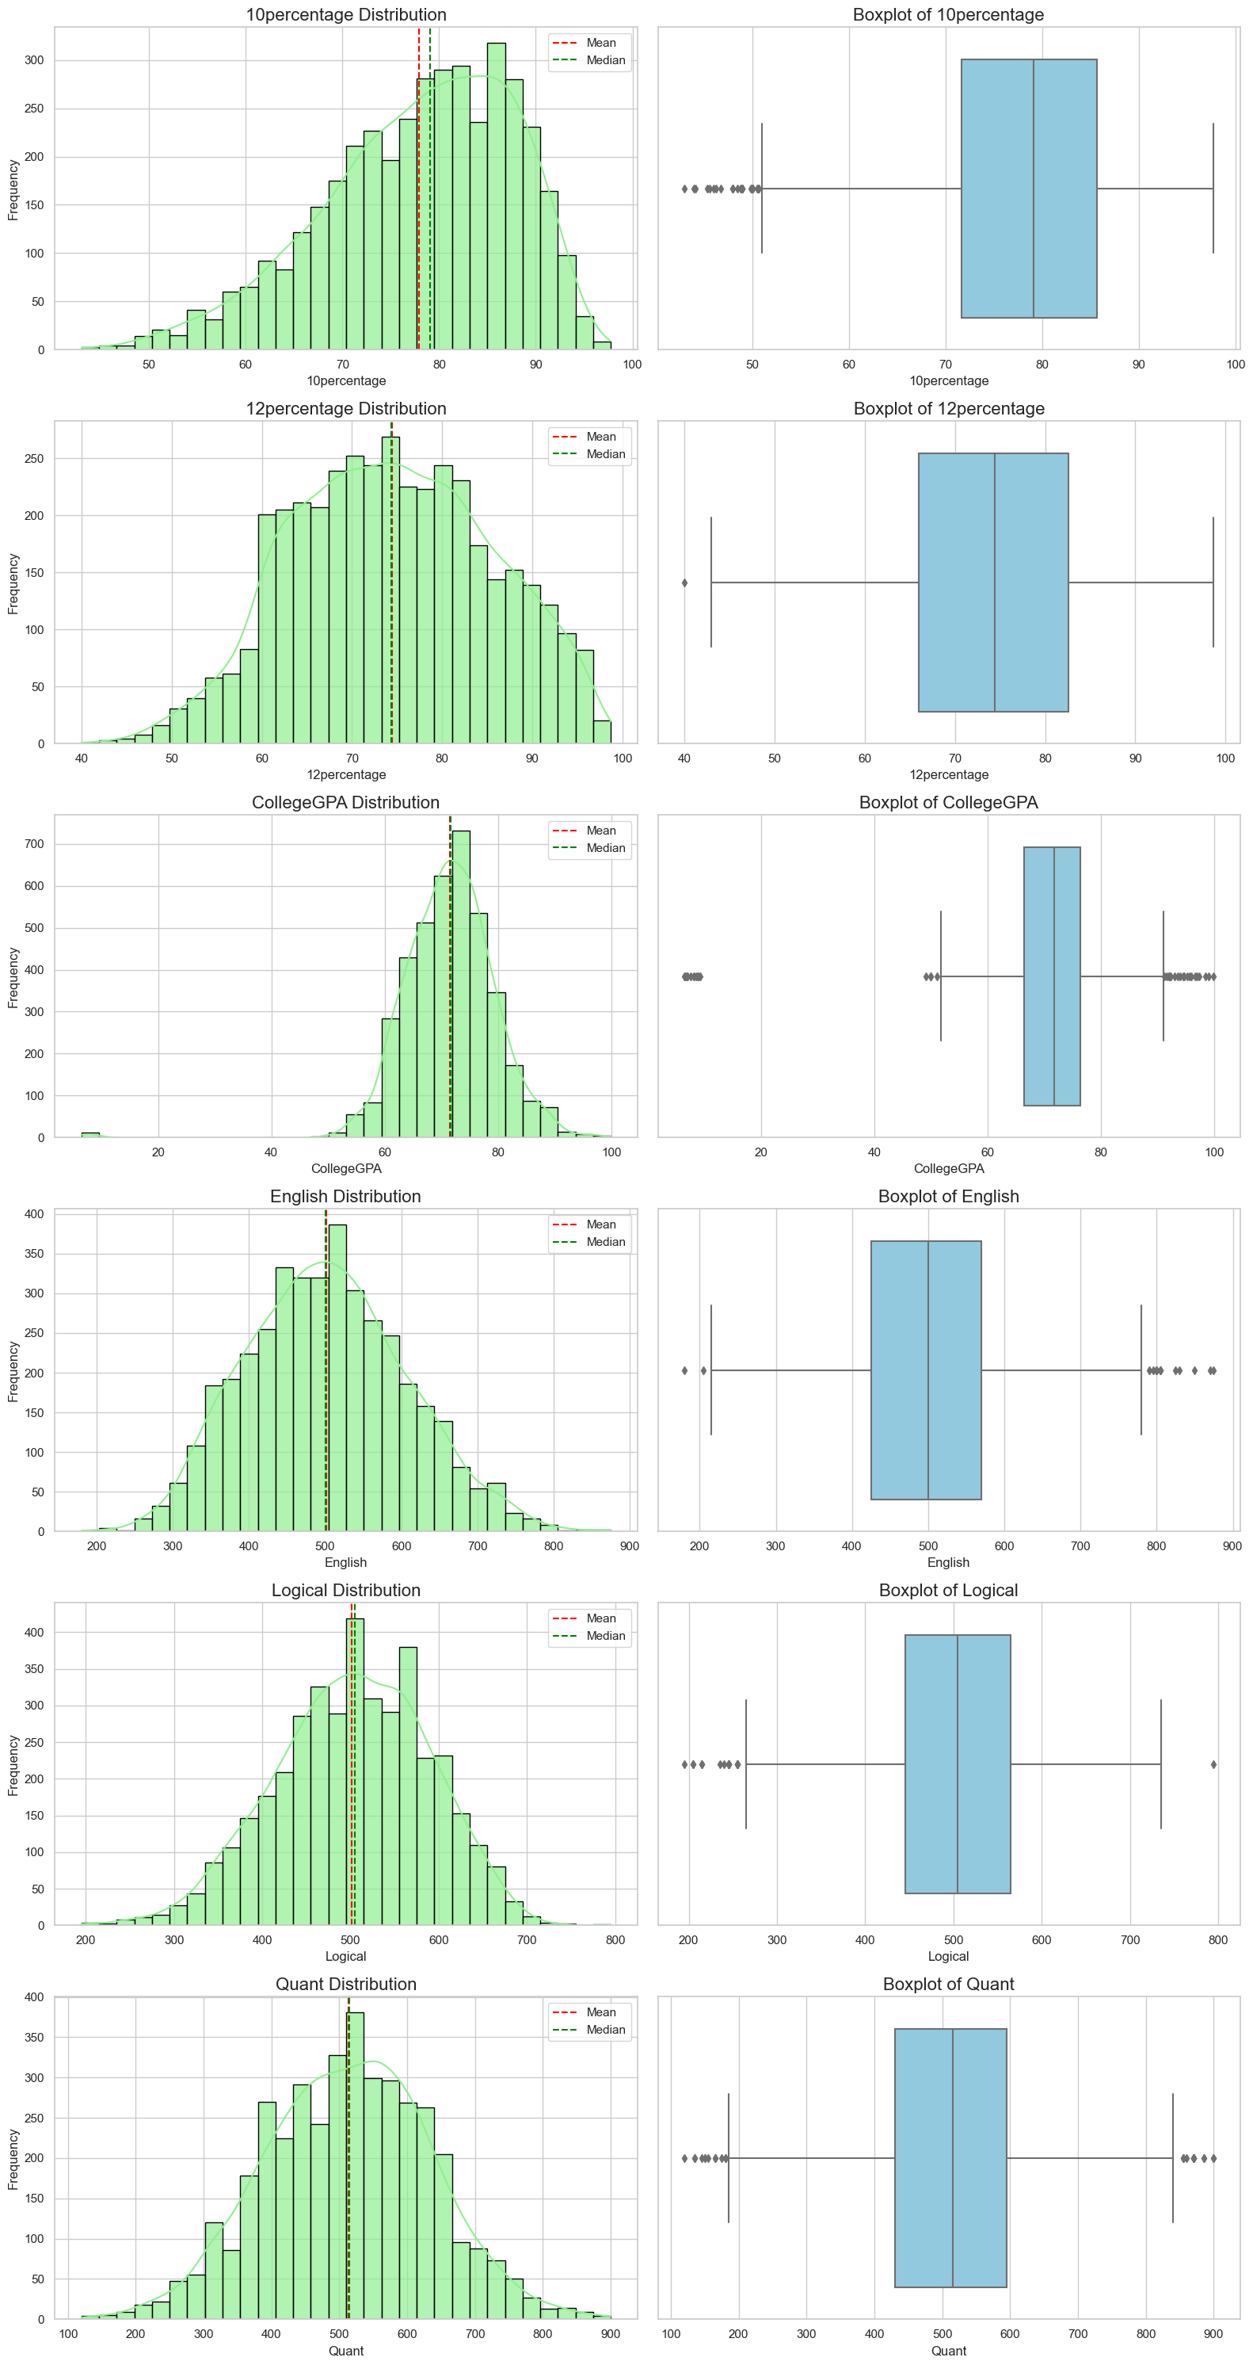
Univariate Analysis of Other Numerical Variables
The distributions(histogram plot) and boxplots suggest that students generally perform within a narrow range for academic scores, while their logical and quantitative scores are more spread out.

Slide 11
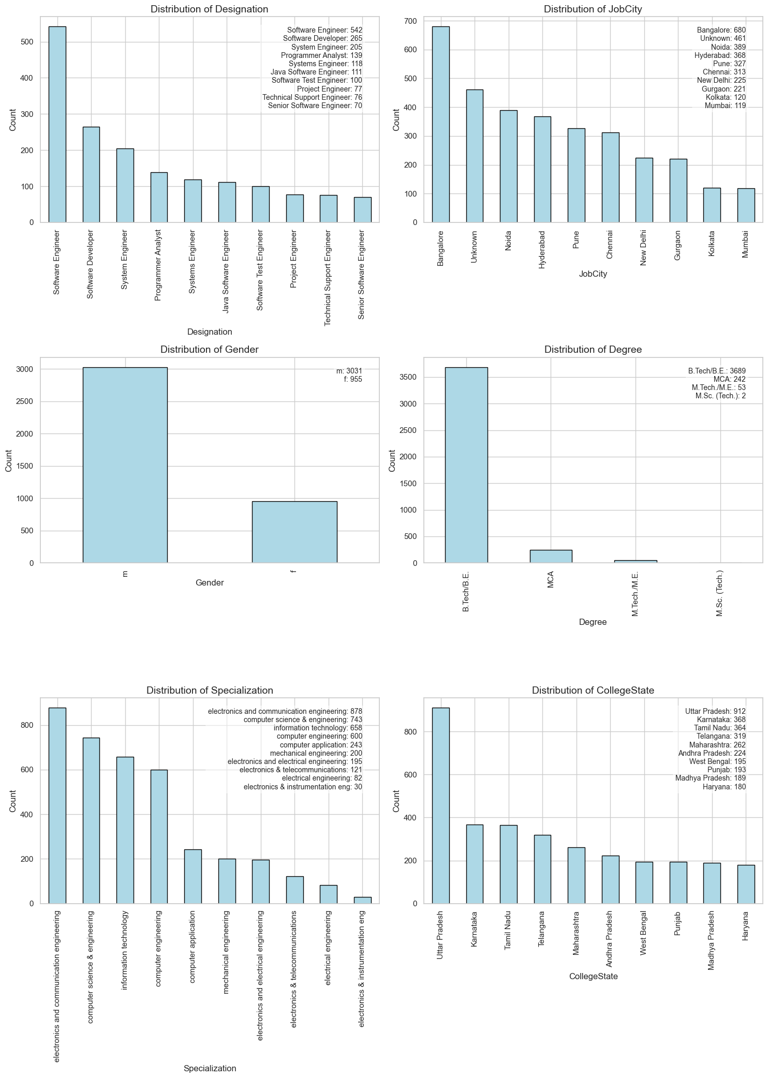
Univariate Analysis of Categorical Variables

Slide 12
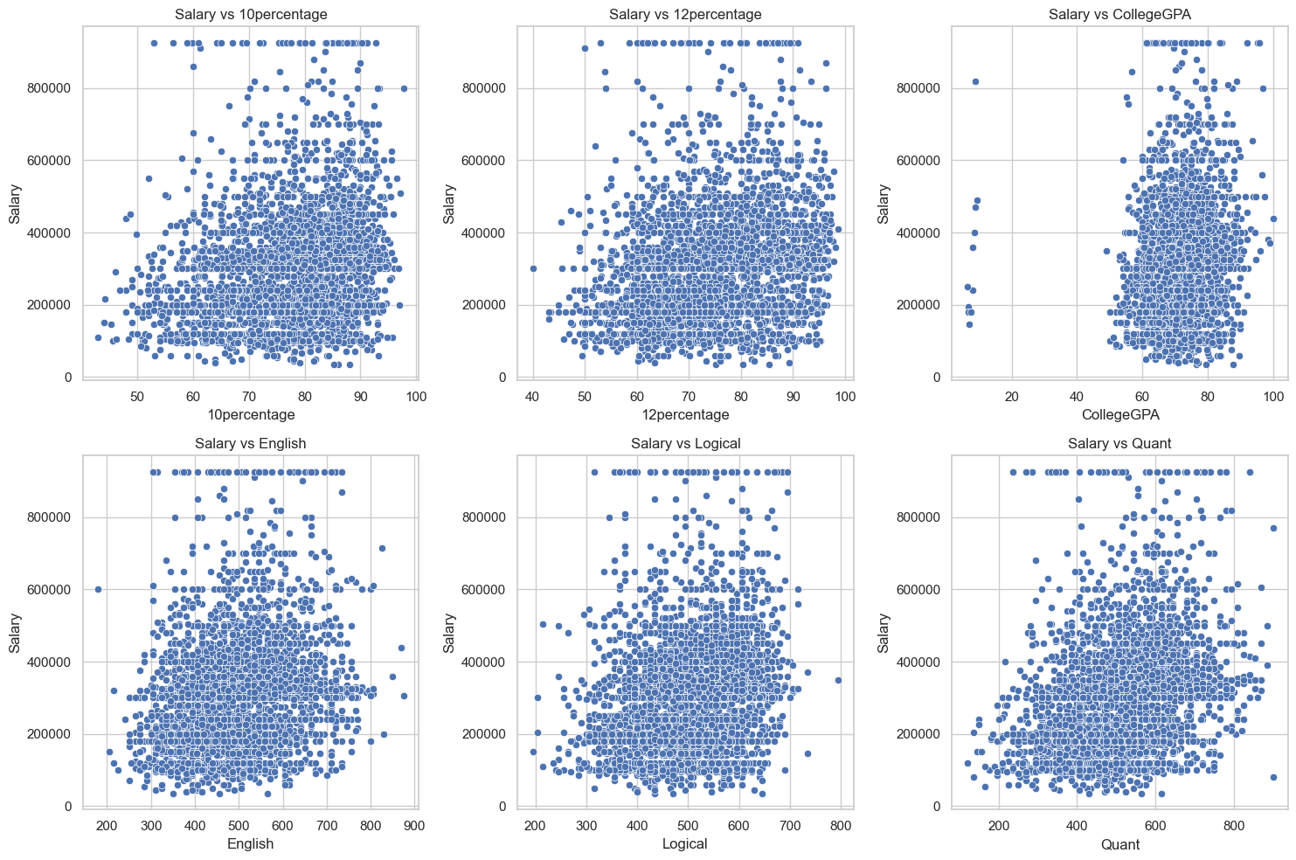
Bivariate Analysis, Salary vs Other Numerical Variables

Slide 13
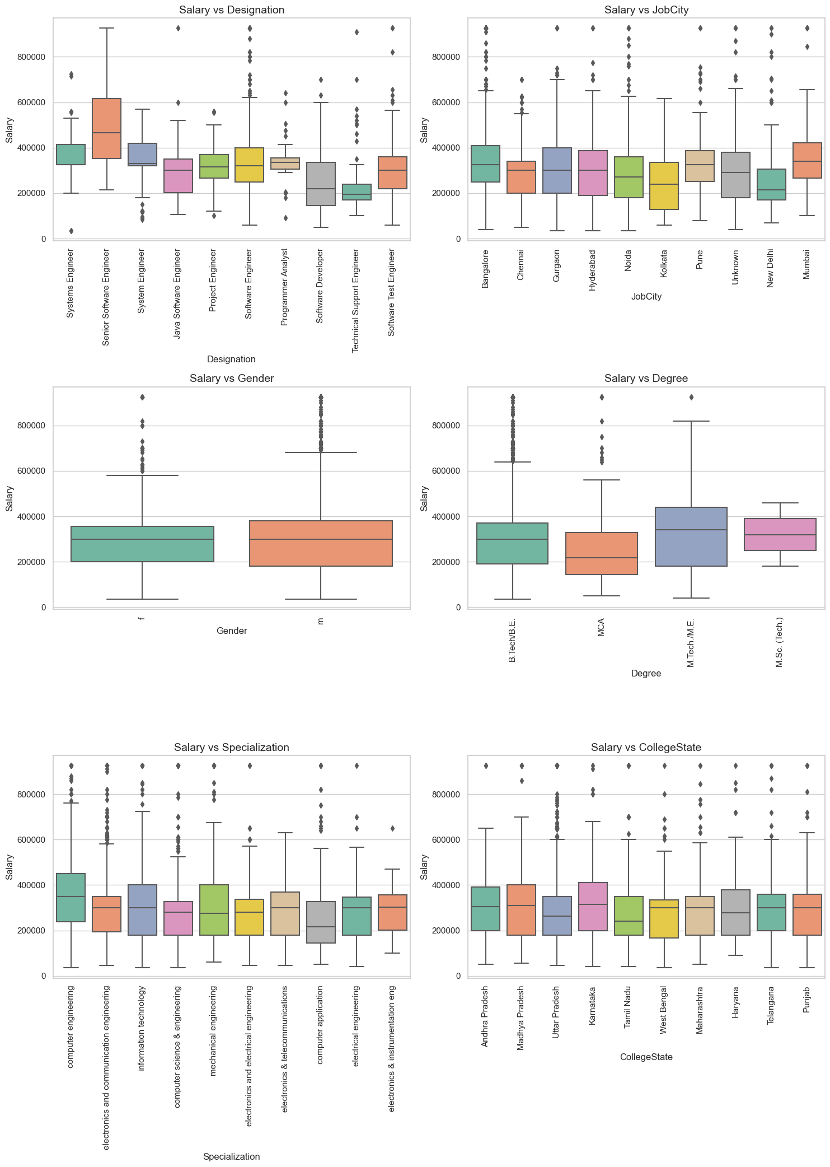
Bivariate Analysis, Salary vs Categorical Variables

Slide 14
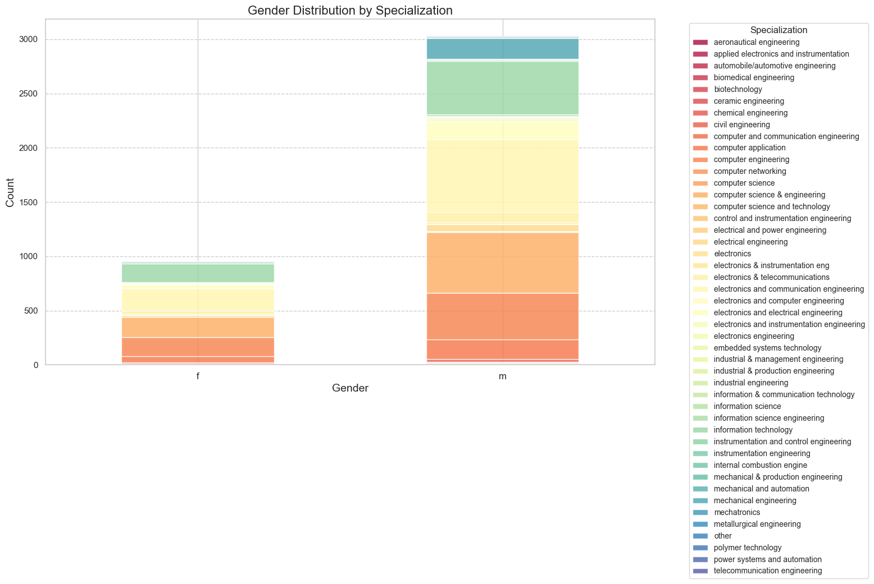
Research Question
The mean salary for fresh B.Tech graduates with Computer Science-related specializations in the Programming Analyst, Software Engineer, Hardware Engineer and Associate Engineer is: 288666.67.
There a relationship between gender and specialization. The overall trend indicates a persistent gender bias in engineering, with women being underrepresented in many areas.
Most Gender-Imbalanced Specializations: Electrical Engineering, Computer Science Engineering, Mechanical Engineering.
Relatively Balanced Specializations: Biomedical Engineering, Chemical Engineering.
Notable Female Representation: Textile Technology, Architecture.

Slide 15
Conclusion
Key Findings:
City Impact: Bangalore dominates in terms of both job frequency and higher salaries.
Designation Matters: Senior roles and more specialized positions offer better salary packages.
Education & Specialization: Higher degrees and specialized engineering fields (like electronics, computer science) are associated with better salaries.
Skills: Academic scores and skill levels (English, Logical, Quant) show some correlation with salary, but they are not the sole determinants.
Salary trends vary significantly by designation, gender, and degree.
Computer Science graduates meet the salary expectations stated by the Times of India article.
There is a relationship between gender and specialization preferences.
Salary discrepancies exist between genders, with males earning higher in some designations.

Slide 16
Challenges and Learnings
Challenges Faced:
Data Cleaning: Handling inconsistency, spelling mistakes and variations in Job City column.
Data Manipulation: Grouping similar specializations and filtering relevant designations.
Visualization: Handling cluttered plots due to the large number of designations and categories.
Learnings:
Gained hands-on experience with pandas, seaborn and matplotlib.
Enhanced skills in handling large datasets and deriving insights from them.

Slide 17

THANK YOU

